Slide 1


Control Flow
Muhammad Zahir Junejo

Slide 2


Lecture - Housekeeping
The use of disrespectful language is prohibited in the questions, this is a supportive, learning environment for all - please engage accordingly.
Please review Code of Conduct (in Student Undertaking Agreement) if unsure
No question is daft or silly - ask them!
Q&A session at the end of the lesson, should you wish to ask any follow-up questions.
Should you have any questions after the lecture, please schedule a mentor session.
For all non-academic questions, please submit a query: www.hyperiondev.com/support
Notes:
A data structure is a particular way of organizing data in a computer so that it can be used effectively.

Slide 3


Controlling the flow of a program
Variable declaration
Setting up conditions and conditional statements
Loops
Lecture Objectives

Slide 4
Intro to JavaScript
Scripting language used for both frontend and backend development.
ECMA created ECMAScript standards which set the groundwork for JavaScript.
New versions of ECMAScript came out over time such as ES6.
Modern browsers like Chrome, Safari and Firefox offer a built-in console that can be used for debugging.
You can also run javascript code directly in the console as well.
Notes:
A data structure is a particular way of organizing data in a computer so that it can be used effectively.

Slide 5
Variables
Variables are used to store the data which we can use for calculations later on.
Like a box that holds information.
We need to declare it first, meaning that we need to assign a storage space in memory and give it a name.
Variable declaration:
let exampleVariable = “Value of the variable”;
You either use the keyword ‘let’ or ‘const’
Then write the name of the variable after leaving a white space.
Notes:
A data structure is a particular way of organizing data in a computer so that it can be used effectively.

Slide 6
Variables
Make sure,
The variable name contains only letters, number and underscores.
Follows a consistent convention like the camelCase.
The variable is not a reserved keyword like let, const or console
Is understandable.
To assign a value to the variable, you use the assignment operator (=) and then the value. Finally end the line with a semicolon (;)
The value assigned to a variable is called a data type.
Notes:
A data structure is a particular way of organizing data in a computer so that it can be used effectively.

Slide 7
Data Types
Numeric → let gameScore = 100;
String → let fullName=”Muhammad Zahir Junejo”;
Boolean → let gameEnd = true;
Array → let playerScores= [100, 200, 400];
Object → let playerProfileData = {firstName: “Zahir”, lastName: “Junejo”};
Arrays are used to store multiple values.
An object is a data type that stores a collection of related data.
JavaScript infers the data type of the variable from the value.
Notes:
A data structure is a particular way of organizing data in a computer so that it can be used effectively.

Slide 8
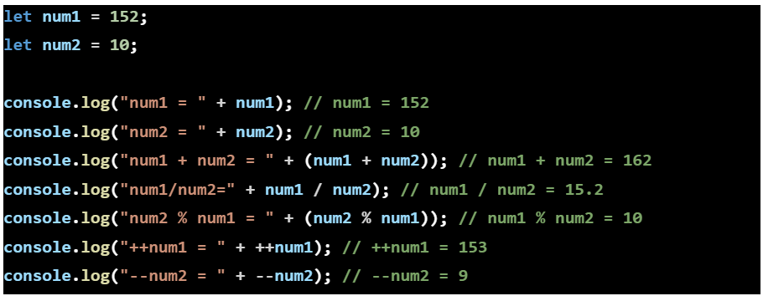
Mathematical Operators
Notes:
A data structure is a particular way of organizing data in a computer so that it can be used effectively.

Slide 9
If Statements
A way of comparing two variables and running an action on the basis of the outcome of the comparison.
Syntax:
if ( condition ) {
Indented statements;
}
Example:
let num = 10;
if ( num > 5 ) {
console.log( “Number is bigger than 5” );
}
Notes:
A data structure is a particular way of organizing data in a computer so that it can be used effectively.

Slide 10
Comparison Operators
a > b → Greater than.
a < b → Less than.
a >= b → Greater than or equal to.
a <= b → Less than or equal to.
a == b → Equals operator.
a === b → Check for equal value and datatype.
a != b or a!==b → Does not equal.
Notes:
A data structure is a particular way of organizing data in a computer so that it can be used effectively.

Slide 11
Logical Operators
AND
let runs = 150;
if ( runs >= 100 && runs <= 200 ) {
console.log(“Keep going, you are almost headed for a double century.”);
}
OR
let runs = 20;
if (runs > 40 || runs > 90) {
console.log(“Keep batting, you are almost hitting a century”);
}
Notes:
A data structure is a particular way of organizing data in a computer so that it can be used effectively.

Slide 12
Else
Syntax:
if (condition) {
Statements to run when condition is true;
} else {
Statements to run when condition is false;
}
Examples:
if (num < 12) {
console.log(“num is less than 12”);
} else {
console.log(“num is greater than 12”);
}
Notes:
A data structure is a particular way of organizing data in a computer so that it can be used effectively.

Slide 13
While loop
Loops help you repeat a task multiple times.
While loops repeat an action until the controlling condition is false.
Syntax:
while ( boolean expression ) {
statements;
}
Example:
while ( num <= 250 ) {
num++;
console.log(num);
}
Notes:
A data structure is a particular way of organizing data in a computer so that it can be used effectively.

Slide 14
For loop
Similar to while loop but structured differently.
Syntax:
for ( declare controlling variable; condition to end loop; increment control variable ) {
Actions to perform over here;
}
Example:
for ( let count = 0; count < 10; count++ ) {
console.log(count);
}
Notes:
A data structure is a particular way of organizing data in a computer so that it can be used effectively.

Slide 15
Break statement
Primarily used to break out of a loop.
Example:
for ( let count = 0; count < 10; count++ ) {
if ( count == 6 ) {
break;
}
console.log(count);
}
Notes:
A data structure is a particular way of organizing data in a computer so that it can be used effectively.

Slide 16


Questions and Answers

Slide 17
References
https://www.programiz.com/javascript/comparison-logical
https://www.programiz.com/javascript/if-else
https://www.programiz.com/javascript/for-loop
https://www.programiz.com/javascript/while-loop
https://www.programiz.com/javascript/break-statement
https://www.programiz.com/javascript/continue-statement
https://www.programiz.com/javascript/switch-statement
Notes:
A data structure is a particular way of organizing data in a computer so that it can be used effectively.

Slide 18
Thank You!

